Slide 1
Project AWESOME: Women in Computing An effort to increase the meaningful participation of Women in Computing @ Baskin Engineering
Adrienne Harrell
Director of Undergraduate Student Affairs
November 13, 2014

Slide 2
Fall 2014: Proposed and Declared Majors in Computing

Slide 3
Baskin Engineering: commitment to increasing the number of women in our CS programs
Current Effort started with top leadership and includes:
National efforts and leadership in CS education
Efforts to strengthen local pipeline of middle and high-school girls
Programs and resources designed to attract, retain and graduate more women in CS

Slide 4
Baskin Engineering: National Work
Engaged with National Center for Women & Information Technology (NCWIT)since 2005 ncwit.org
NCWIT research, networks, best-practices, evaluation resources, and professional alliances: Academic, work-force, K-12, Entrepreneurial
Former BSOE Associate Dean currently serves as Co-Chair of Academic Alliance.
Pacesetters~ Accelerated work of Academic and Work-force Alliances to increase the number of women in Computing
Grace Hopper Celebration of Women in Computing~Academic sponsorship the last two years & sending increasing # of students

Slide 5
Strengthening the local Pipeline: Efforts to expose and encourage middle and high-school women to consider computer science.
Girls in Engineering (GIE)~one week computing focused camp for middle school girls free of charge and includes transportation. GIE targets educationally-disadvantaged girls from the greater Santa Cruz/Monterey Bay area. Two one-week session serving 24 students are offered each summer. http://gie.soe.ucsc.edu
C.O.S.M.O.S. Video Game and Computer Networking & Astronomy Clusters~ Four week summer residential program designed for talented and highly motivated high school students allows them to work closely with faculty and a high-school teaching fellow. http://cosmos.ucsc.edu
Bay Area Affiliate NCWIT Award for Aspirations in Computing~Established the Bay area affiliate of this national and regional award program recognizing the computing aspirations of high school women. Baskin Engineering offers a $16,000 for Aspirations Award winners who attend UCSC and major in CS. http://www.aspirations.org/

Slide 6
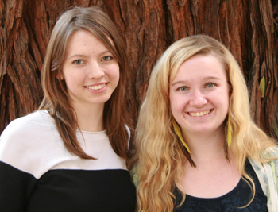
Project AWESOME: Women in Computing
Launched in 2011 w/a direct mail campaign to incoming students
Re-launched in 2013 with small grant to fund student staff support and activities
Hired two undergraduate women in CS to shape and organize activities

Slide 7
Project AWESOME Activities 2013-14
Direct Mail campaign and reception invitation (August)
Project AWESOME Tea (October)
Conference Support: She’s Geeky and GHC (January)
Study Groups for lower division CS courses (Winter/Spring Quarters)
Girls in Engineering Alumni Day (May)
Weekly meetings/coffee hour with guest speakers (Spring Quarter)

Slide 8
Project AWESOME Participation in 2013-14
Direct mail: 109 students targeted
Reception: 24 incoming students attended in addition to graduate students, faculty and staff
Project AWESOME supported two women to attend the She’s Geeky conference
Study Groups: 38 students participated in one or more CS study groups organized by Project AWESOME
GIE Alumnae Day: 17 GIE alumnae participated and 11 female undergraduates served as mentors

Slide 9
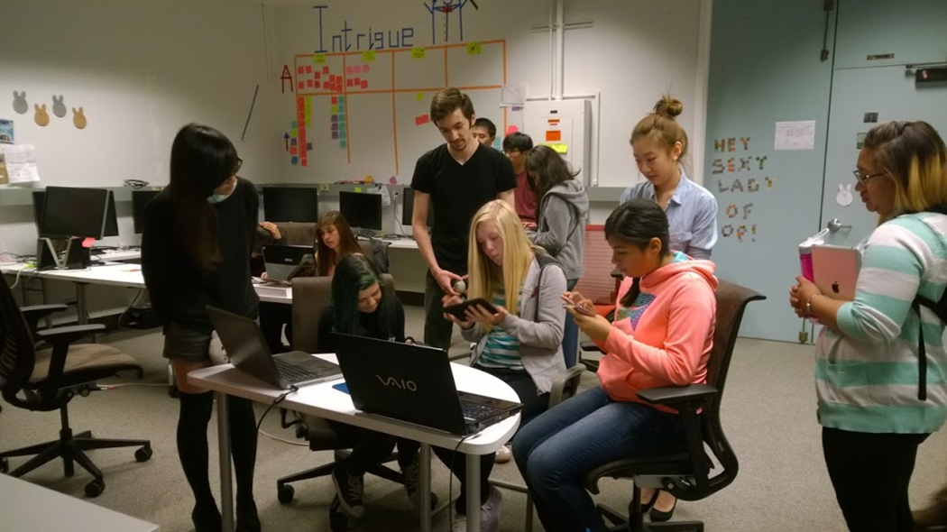
GIE alumnae play-testing video games

Slide 10
Project AWESOME 2014-15
Continuing many components from 2013-14
Expanded Direct Mail campaign to incoming students
Launch and invitation for Peer Mentor Program
Established Study Groups and Weekly meeting at start of Fall Quarter
Planning to attend Hack-a-thon
Company Visits
Tee-shirts!

Slide 11
Project AWESOME: Impacting the participation of women in computing but it takes a village
Faculty
Teaching Assistants and Tutors
Academic Advisers
Peer Mentors

Slide 12
Project AWESOME: Women in Computing

Slide 13
What we say and do matters…

